Slide 1
Unit 3: Text-Based Programming
Lesson 10

Slide 2
Building Commands into your Bot
Now that you have learned how to use selection, you can use these skills to upgrade the bot you created last week so that it can help you do more.
At the moment, your bot is only useful for adding numbers together. Let’s change it so it can also subtract numbers.
You will need to add the code to:
Get a command from the user using input. Does the user want to add or subtract?
Use an if, then, elif, else to choose whether the bot is adding or subtracting.
Add the code to get two numbers from the user, and the code to subtract them (when required).

Slide 3
Open Your Bot Program
The first step is to use input to get a command from the user when your bot starts. If the command “add” is entered, your bot will add two numbers, using the code you’ve already written. Go back to your bot code by opening the “adding_bot” program you created last week.

Slide 4
Make a copy of your bot
Double click on the filename in the tab if you are using Mu. If you are using another IDE then you should be able to use “Save As”.
Save your project as bot_2

Slide 5
Add an “add” command
Add the code to get a command from your user under the first print statement (where the bot says Hi, I am Marvin, your personal bot). command = input("How can I help? ")
After you have got the command from the user, use an if statement to see if it is “add”. if command == "add":

Slide 6
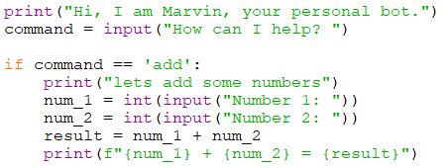
Below this if statement, you should then indent all the code to add numbers, so that it is part of the if and therefore only runs when the user enters the command “add”.

Slide 7
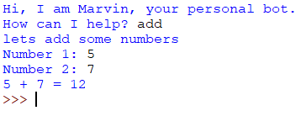
Run your program to test it. If you enter the command “add” your bot should ask you for two numbers and add them together. If you enter anything else, the program should just finish.

Slide 8
Add a “subtract” command
In this next step, you will add the code to enable your bot to subtract numbers. After this you will have the opportunity and challenge to add more code to undertake other tasks.
Add an elif to the end of your program to test if the command is equal to "subtract". Note: the elif is not indented and is in line with the if.

Slide 9
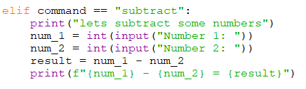
Indented under the elif, add the code to subtract two numbers. It is very similar to the code for adding. Tip: it’s OK to copy and paste when you have to repeat some code.
Run your program and test it.

Slide 10

As a last step, add a message so that if a command the bot doesn’t understand is entered, it responds with sorry I dont understand.
Add an else to the end of your program to print a message if it doesn’t understand the command.

Slide 11
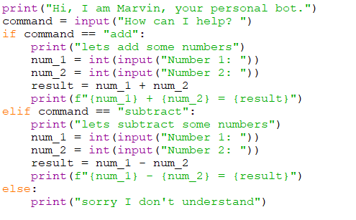
Your complete program should now look like this:

Slide 12
Portfolio 6 – Bot 2
Update your program so it can:
solve division and multiplication problems when given the commands “divide” or “multiply”. Save your file as your_name_u3_port_6

